Slide 1
Ethics in Information Technology, Fourth Edition
Chapter 6
Intellectual Property

Slide 2
Objectives
As you read this chapter, consider the following questions:
  What does the term intellectual property encompass, and why are organizations so concerned about protecting intellectual property?
  What are the strengths and limitations of using copyrights, patents, and trade secret laws to protect intellectual property?
  What is plagiarism, and what can be done to combat it?
Ethics in Information Technology, Fourth Edition

Slide 3
Objectives (cont’d.)
  What is reverse engineering, and what issues are associated with applying it to create a look-alike of a competitor’s software program?
  What is open source code, and what is the fundamental premise behind its use?
  What is the essential difference between competitive intelligence and industrial espionage, and how is competitive intelligence gathered?
  What is cybersquatting, and what strategy should be used to protect an organization from it?
Ethics in Information Technology, Fourth Edition

Slide 4
What Is Intellectual Property?
Term used to describe works of the mind
  Distinct and “owned” or created by a person or group
Copyright law
  Protects authored works
Patent law
  Protects inventions
Trade secret law
  Helps safeguard information critical to an organization’s success(example any formula or design)
Ethics in Information Technology, Fourth Edition

Slide 5
Copyrights
Established in the U.S. Constitution
  Article I, Section 8, Clause 8
  the exclusive and assignable legal right, given to the originator for a fixed number of years, to print, publish, perform, film, or record literary, artistic, or musical material.
Grants creators of original works the exclusive right to:
  Distribute
  Display
  Perform
  Reproduce work
  Prepare derivative works based upon the work
Author may grant exclusive right to others
Ethics in Information Technology, Fourth Edition

Slide 6
Copyrights (cont’d.)
Types of work that can be copyrighted
  Architecture
  Art
  Audiovisual works
  Choreography
  Drama
  Graphics
  Literature
  Motion pictures
Ethics in Information Technology, Fourth Edition

Slide 7
Copyrights (cont’d.)
Types of work that can be copyrighted (cont’d.)
  Music
  Pantomimes
  (a theatrical entertainment, mainly for children, which involves music, topical jokes, and comedy and is based on a fairy tale or nursery story, usually produced around Christmas)
  Pictures
  Sculptures
  Sound recordings
  Other intellectual works:
Ethics in Information Technology, Fourth Edition

Slide 8
Copyrights (cont’d.)
Must fall within one of the preceding categories
Must be original
  Evaluating originality can cause problems
Fair use doctrine
  Allows portions of copyrighted materials to be used without permission under certain circumstances
  Maintains balance between protecting an author’s rights and enabling public access to copyrighted works
  quoting from a copyrighted work in order to criticize or comment upon it or teach students about it
  Factors to consider when evaluating the use of copyrighted material
Ethics in Information Technology, Fourth Edition

Slide 9
Copyrights (cont’d.)
Fair use doctrine factors include:
  Purpose and character of the use
  Nature of the copyrighted work
  Portion of the copyrighted work used
  Effect of the use upon the value of the copyrighted work
  Key concept: an idea cannot be copyrighted, but the expression of an idea can be
Ethics in Information Technology, Fourth Edition

Slide 10
example
An author cannot copy the exact words that someone else used to describe his feelings during a World War 2 battle, but he can convey the sense of horror that the other person expressed.
Ethics in Information Technology, Fourth Edition

Slide 11
Copyrights (cont’d.)
Copyright infringement
the action of breaking the terms of a law, agreement, etc.; violation.
  Copy substantial and material part of another’s copyrighted work
  Without permission
  Example
  If 2 writers happened to use the same phrase to describe a key historical fig. neither would be guilty of infringement
  https://www.socialsamosa.com/2012/03/case-of-copyright-infringement-by-zee-khana-khazana/
Software copyright protection
  Raises many complicated issues of interpretation
Ethics in Information Technology, Fourth Edition

Slide 12
Copyrights (cont’d.)
World Intellectual Property Organization (WIPO)
  Agency of the United Nations
  Advocates for the interests of intellectual property owners
  WIPO Copyright Treaty provides additional copyright protections for electronic media
Ethics in Information Technology, Fourth Edition

Slide 13
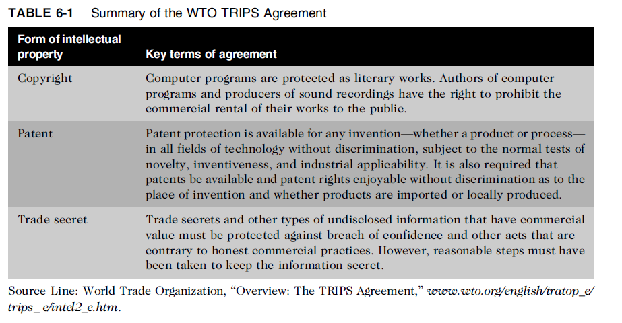
Copyrights (cont’d.)
Ethics in Information Technology, Fourth Edition

Slide 14
Copyrights (cont’d.)
Digital Millennium Copyright Act (DMCA)
  Civil and criminal penalties included
  Governs distribution of tools and software that can be used to find a way out technological measures used to protect copyrighted works
  Provides safe harbors for ISPs whose customers/subscribers may be breaking copyright laws
    ISP must comply with “notice and takedown procedures” that grant copyright holders a process to halt access to alleged infringing content
Ethics in Information Technology, Fourth Edition

Slide 15
Owners of copyrighted material who allege that their material has been infringed send a notice to ISP hosting the content.
The ISP forwards the notice to whoever was responsible for uploading material.
That individual is given a chance to respond.
If there is no response, the ISP must ensure that the material is no longer accessible.
Ethics in Information Technology, Fourth Edition

Slide 16
example
https://www.socialsamosa.com/2012/03/case-of-copyright-infringement-by-zee-khana-khazana/
https://99designs.com/blog/tips/5-famous-copyright-infringement-cases/
Ethics in Information Technology, Fourth Edition

Slide 17
Patents
Grant of property right to inventors
Issued by the U.S. Patent and Trademark Office (USPTO)
Permits an owner to exclude the public from making, using, or selling the protected invention
Allows legal action against violators
Prevents independent creation as well as copying
A patent is an exclusive right granted for an invention, which is a product or a process that provides, in general, a new way of doing something, or offers a new technical solution to a problem
Ethics in Information Technology, Fourth Edition

Slide 18
Patents (cont’d.)
Applicant must file with the USPTO
  USPTO(United states Patent and Trademark office) searches prior art
  Takes an average of 35.3 months from filing an application until application is issued as a patent or abandoned
Prior art
  Existing body of knowledge
  Available to a person of ordinary skill in the art
Ethics in Information Technology, Fourth Edition

Slide 19
Patents (cont’d.)
An invention must pass four tests
  Must be in one of the five statutory classes of items
  Processes ,machines, manufactures, composition of matter and new uses in four previous classes
  Must be useful
  Must be novel
  Must not be obvious to a person having ordinary skill in the same field
Items cannot be patented if they are:
  Abstract ideas
  Laws of nature
  Natural phenomena(artifical rain)
Ethics in Information Technology, Fourth Edition

Slide 20
Patents (cont’d.)
Patent infringement
  Making unauthorized use of another’s patent
  No specified limit to the monetary penalty
Software patent
  Protects feature, function, or process embodied in instructions executed on a computer
20,000 software-related patents per year have been issued since the early 1980s
Ethics in Information Technology, Fourth Edition

Slide 21
Patent Filling process
http://www.mondaq.com/india/x/403564/Patent/Patent+Law+In+India+Everything+You+Must+Know
Ethics in Information Technology, Fourth Edition

Slide 22
Patents (cont’d.)
Before obtaining a software patent, do a patent search(Patent search is a search made to determine whether a particular invention is novel when it is invented. This is done to check whether an invention may qualify for a patent. A patent search is usually done by searching the database of previously issued patents)
Software Patent Institute is building a database of information
Average patent lawsuit costs $3 - $10 million
Ethics in Information Technology, Fourth Edition

Slide 23
Patents (cont’d.)
Defensive publishing
  Alternative to filing for patents
  Company publishes a description of the innovation
  Establishes the idea’s legal existence as prior art
  Costs mere hundreds of dollars
  No lawyers
  Fast
  prevents other parties from obtaining a patent on the product, device or method
  Patent troll firm
  Acquires patents with no intention of manufacturing anything; instead, licensing the patents to others
  A patent troll is an individual or business entity that willfully files — or purchases — patents for the sole purpose of keeping others from using them.
  .
Ethics in Information Technology, Fourth Edition

Slide 24
Patents (cont’d.)
http://www.makeuseof.com/tag/apple-bendy-iphone-android-tv-google-tv-tech-news-digest/ttp://www.freepatentsonline.com/crazy.html
https://www.popularmechanics.com/technology/gadgets/reviews/g558/101-gadgets-that-changed-the-world-patents/
http://www.makeuseof.com/tag/patent-trolling-affect/
http://www.ipindia.nic.in/form-and-fees.htm(forms)
Submarine patent
  Patented process/invention hidden within a standard
  Does not surface until standard is broadly adopted
Ethics in Information Technology, Fourth Edition

Slide 25
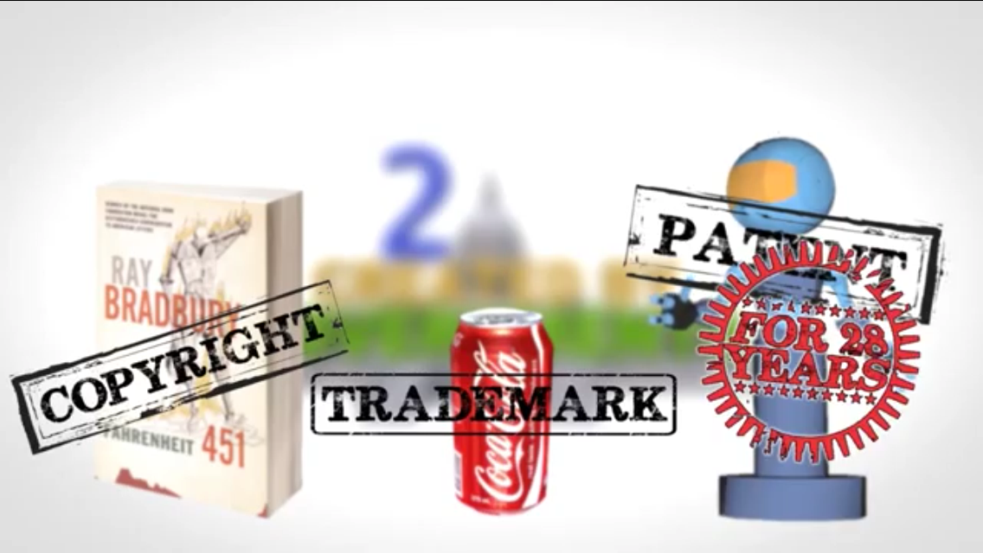
Patents (cont’d.)
Patent farming involves:
  Influencing a standards organization to make use of a patented item without revealing the existence of the patent
  https://whatchamacallits.wordpress.com/submarine-patents-patent-farming/
Ethics in Information Technology, Fourth Edition

Slide 26
Patent filling process
http://www.invntree.com/blogs/how-much-does-it-cost-get-patent-india
http://www.invntree.com/blogs/patent-application-filing-procedureprocess-india
Ethics in Information Technology, Fourth Edition

Slide 27
Trade Secrets
Trade secret
  Business information
  Represents something of economic value
  Requires an effort or cost to develop
  Some degree of uniqueness or novelty
  Generally unknown to the public
  Kept confidential
Information is only considered a trade secret if the company takes steps to protect it
Ethics in Information Technology, Fourth Edition

Slide 28
Trade Secrets (cont’d.)
Trade secret law has a few key advantages over patents and copyrights
  No time limitations
  No need to file an application
  Patents can be ruled invalid by courts
  No filing or application fees
Law doesn’t prevent someone from using the same idea if it is developed independently
Trade secret law varies greatly from country to country
Ethics in Information Technology, Fourth Edition

Slide 29
Employees and Trade Secrets
Employees are the greatest threat to trade secrets
Unauthorized use of an employer’s customer list
  Customer list is not automatically considered a trade secret
  Educate workers about the confidentiality of lists
Nondisclosure clauses in employee’s contract
  Enforcement can be difficult
  Confidentiality issues are reviewed at the exit interview
Ethics in Information Technology, Fourth Edition

Slide 30
Employees and Trade Secrets (cont’d.)
Noncompete agreements
  Protect intellectual property from being used by competitors when key employees leave
  Require employees not to work for competitors for a period of time
  Wide range of treatment on noncompete agreements among the various states
Ethics in Information Technology, Fourth Edition

Slide 31
Key Intellectual Property Issues
Issues that apply to intellectual property and information technology
  Plagiarism
  Reverse engineering
  Open source code
  Competitive intelligence
  Trademark infringement
  Cybersquatting
Ethics in Information Technology, Fourth Edition

Slide 32
Plagiarism
Stealing someone’s ideas or words and passing them off as one’s own
Many students:
  Do not understand what constitutes plagiarism
  Believe that all electronic content is in the public domain
Plagiarism is also common outside academia
Plagiarism detection systems
  Check submitted material against databases of electronic content
Ethics in Information Technology, Fourth Edition

Slide 33
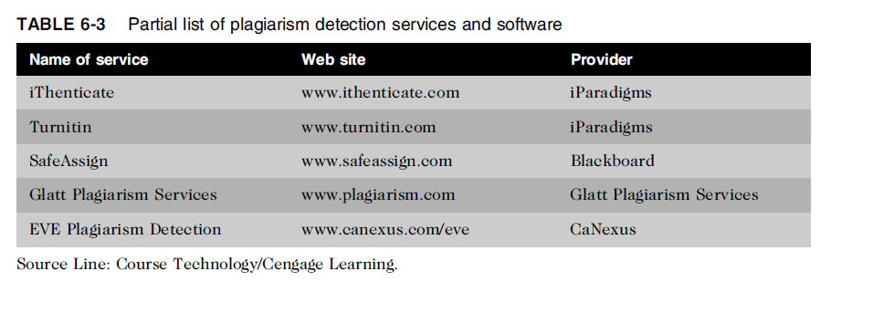
Plagiarism (cont’d.)
Ethics in Information Technology, Fourth Edition

Slide 34
Plagiarism (cont’d.)
Steps to combat student plagiarism
  Help students understand what constitutes plagiarism and why they need to cite sources
  Show students how to document Web pages
  Schedule major writing assignments in portions due over the course of the term
  Tell students that instructors are aware of Internet paper mills and plagiarism detection services
  Incorporate detection into an antiplagiarism program
Ethics in Information Technology, Fourth Edition

Slide 35
Reverse Engineering
Process of taking something apart in order to:
  Understand it
  Build a copy of it
  Improve it
Applied to computer:
  Hardware
  Software
Reverse engineering, also called back engineering, is the process of where a man-made object is deconstructed to reveal its designs, architecture, or to extract knowledge from the object. This process is similar to scientific research but the only difference is that scientific research is about a natural phenomenonConvert an application that ran on one vendor’s database to run on another’s(access to oracle)
https://ethics.csc.ncsu.edu/intellectual/reverse/study.php
Ethics in Information Technology, Fourth Edition

Slide 36
Whether it's rebuilding a car engine or diagramming a sentence, people can learn about many things simply by taking them apart and putting them back together again. That, in a nutshell, is the concept behind reverse-engineering—breaking something down in order to understand it, build a copy or improve it.
https://www.computerworld.com/article/2585652/app-development/reverse-engineering.html
Ethics in Information Technology, Fourth Edition

Slide 37
Reverse Engineering (cont’d.)
Compiler
  Language translator
  Converts computer program statements expressed in a source language to machine language
Software manufacturer
  Provides software in machine language form
Decompiler
  Reads machine language
  Produces source code
Ethics in Information Technology, Fourth Edition

Slide 38
Reverse Engineering (cont’d.)
Courts have ruled in favor of reverse engineering:
  To enable interoperability
Software license agreements forbid reverse engineering
Ethics of using reverse engineering are debated
  Fair use if it provides useful function/interoperability
  Can uncover designs that someone else has developed at great cost and taken care to protect
Ethics in Information Technology, Fourth Edition

Slide 39
Open Source Code
Program source code made available for use or modification:
  As users or other developers see fit
Basic premise
  Many programmers can help software improve
  Can be adapted to meet new needs
  Bugs rapidly identified and fixed
  High reliability
  Facebook,google(frontend source code is available)
Ethics in Information Technology, Fourth Edition

Slide 40
Competitive Intelligence
Gathering of legally obtainable information
  To help a company gain an advantage over rivals
Often integrated into a company’s strategic plans and decision making
Not the same as industrial espionage, which uses illegal means to obtain business information not available to the general public
Without proper management safeguards, it can cross over to industrial espionage
Ethics in Information Technology, Fourth Edition

Slide 41
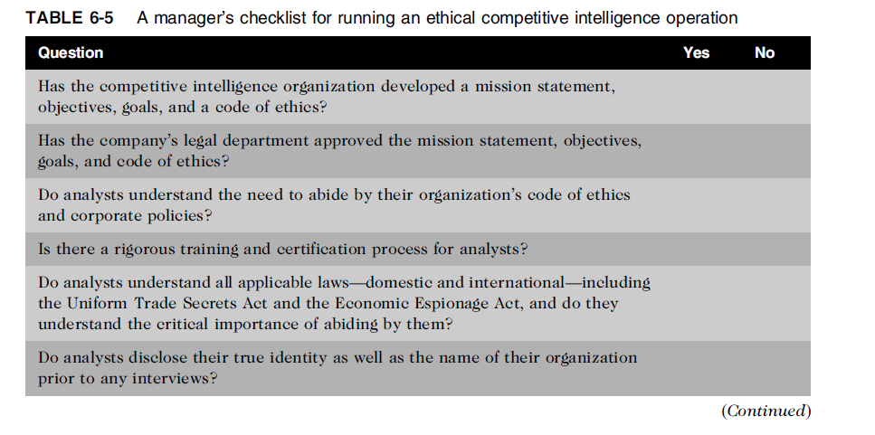
Competitive Intelligence (cont’d.)
Ethics in Information Technology, Fourth Edition

Slide 42
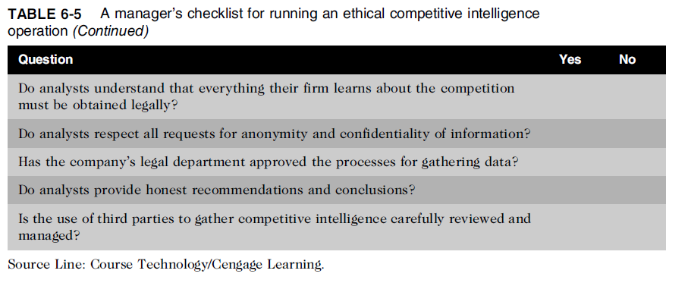
Competitive Intelligence (cont’d.)
Ethics in Information Technology, Fourth Edition

Slide 43
Trademark Infringement
Trademark is logo, package design, phrase, sound, or word that enables consumer to differentiate one company’s product from another’s
Trademark owner can prevent others from using the same mark or a confusingly similar mark on a product’s label
Organizations frequently sue one another over the use of a trademark in a Web site or domain name
Nominative fair use is defense often employed by defendant in trademark infringement case
https://vakilsearch.com/advice/trademark-infringement-india/
Ethics in Information Technology, Fourth Edition

Slide 44
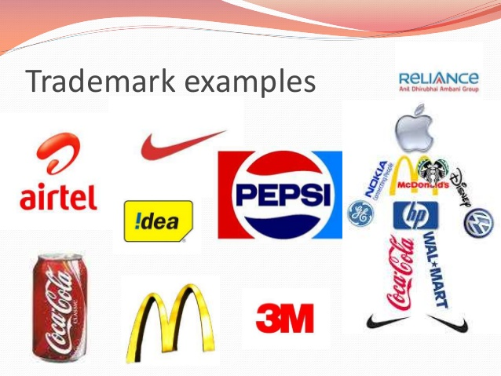
Ethics in Information Technology, Fourth Edition

Slide 45
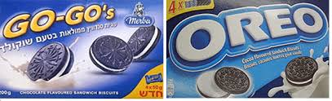
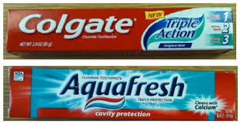



Trademark infringement examples
Ethics in Information Technology, Fourth Edition

Slide 46
Cybersquatting
Cybersquatters
  Register domain names for famous trademarks or company names
  the practice of registering names, especially well-known company or brand names, as Internet domains, in the hope of reselling them at a profit.
  act of registering, trafficking in or using a domain name in bad faith. Cybersquattersneglect the existence of a trademark to profit from others. In fact, domain names are cheap and are sold on a "first come, first served" basis.
To curb cybersquatting, register all possible domain names
  .org, .com, .info
  https://www.nolo.com/legal-encyclopedia/cybersquatting-what-what-can-be-29778.html
Ethics in Information Technology, Fourth Edition

Slide 47
Cybersquatting (cont’d.)
Internet Corporation for Assigned Names and Numbers (ICANN)
  Several top-level domains (.com, .edu, edu., .gov, .int, .mil, .net, .org, aero, .biz, .coop, .info, .museum, .name, .pro, .asis, .cat, .mobi, .tel, and .travel)
  https://blog.ipleaders.in/cybersquatting-position-india/
Ethics in Information Technology, Fourth Edition

Slide 48
http://infomory.com/famous/ten-famous-examples-of-cyber-squatting/
https://www.huffingtonpost.in/2016/04/18/domain-squatting-india_n_9717786.html
Ethics in Information Technology, Fourth Edition

Slide 49
Summary
Intellectual property is protected by laws for:
  Copyrights
  Patents
  Trademarks
  Trade secrets
Plagiarism is stealing and passing off the ideas and words of another as one’s own
Reverse engineering
  Process of breaking something down in order to understand, build a copy of, or improve it
Ethics in Information Technology, Fourth Edition

Slide 50
Summary (cont’d.)
Open source code
  Made available for use or modification as users or other developers see fit
Competitive intelligence
  Uses legal means and public information
Trademark infringement
  Use of other’s trademark in a Web site can lead to issues
Cybersquatting
  Registration of a domain name by an unaffiliated party
Ethics in Information Technology, Fourth Edition

